Slide 1
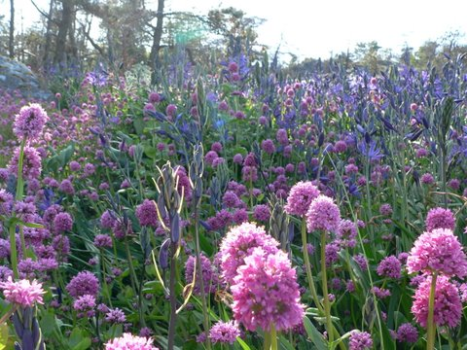


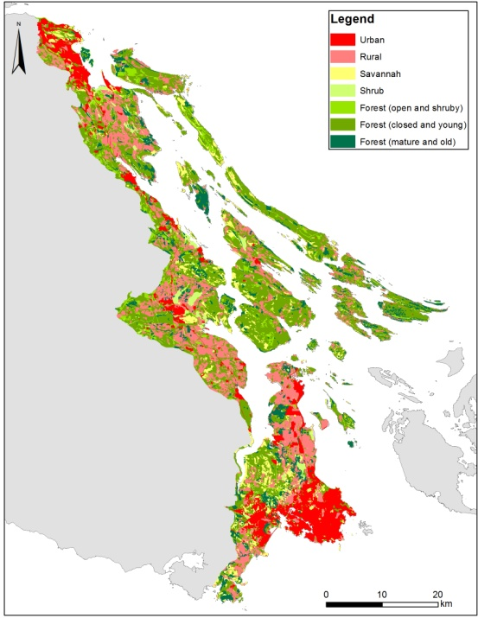
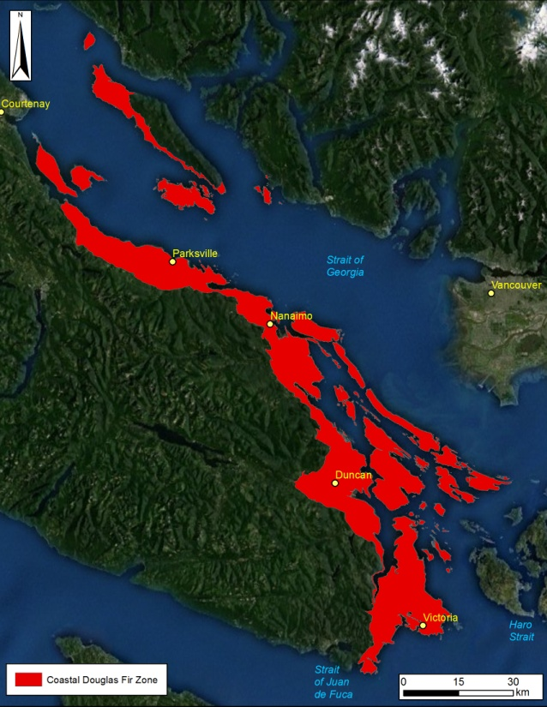
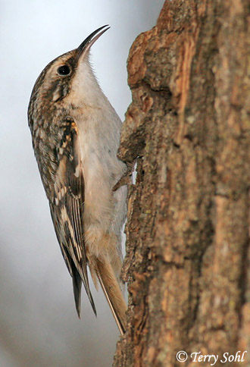
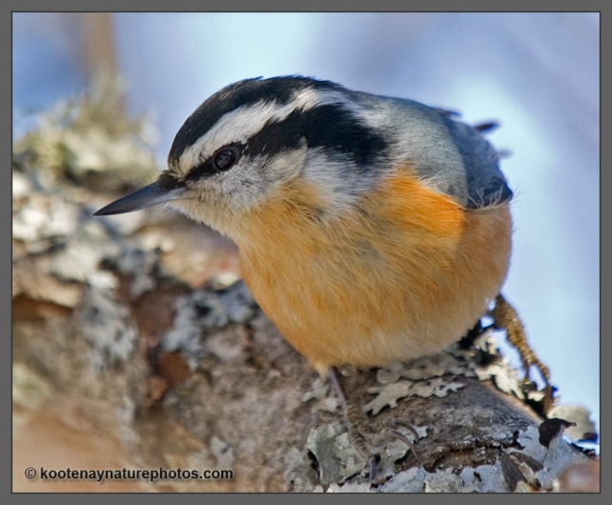
Introduction to conservation prioritization tools
Richard Schuster
Liber Ero Fellow, Carleton University
Adjunct Prof, Ecosystem Science and Management Program, UNBC

Slide 2
How can we combine all this information in a meaningful way for conservation?
Decision support tools: Marxan
Planning units (e.g. properties, watersheds, hexagons, …)
Species or Feature targets (e.g. protect 20% old forest, …)
Create compact reserve systems to reduce e.g. edge effects

Slide 3
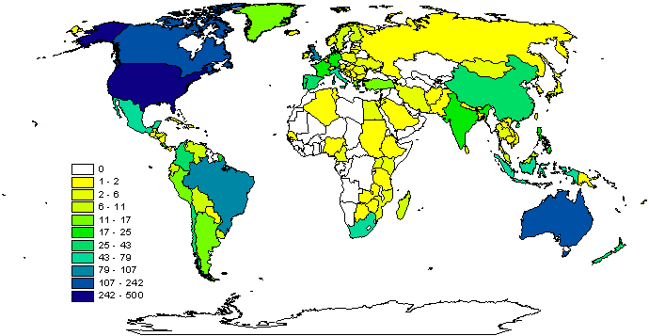
Why Marxan?
Aids systematic conservation planning
Near optimal spatial reserve systems
Most widely used worldwide
Transparent, inclusive and defensible decision making process
2009

Slide 4
What can Marxan do?
Identify areas that meet targets for a range of input features for minimal cost
Uses concept of complementarity (Select new conservation areas so that each one complements the others in the biodiversity features they contain)
Can maximise compactness
Can include data on ecological processes, threats, and condition
Decision-support, not a decision-maker

Slide 5
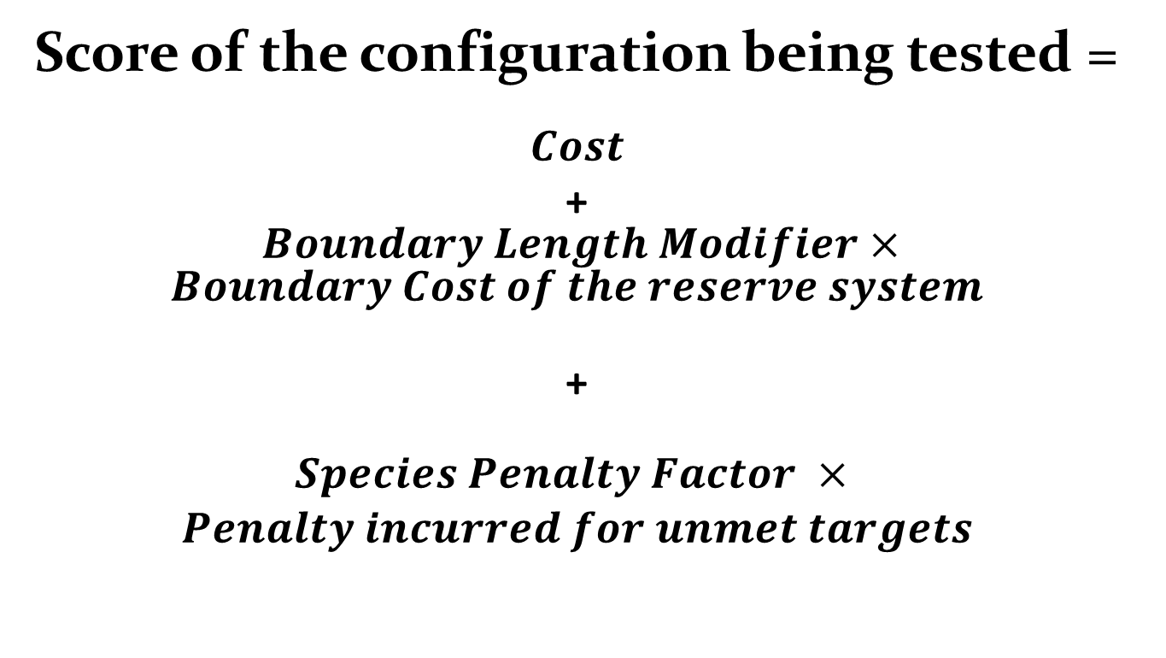
What problem does Marxan solve?
Score of the configuration being tested =
$$Cost$$
+ $Boundary Length Modifier×Boundary Cost of the reserve system$
+
$$\begin{aligned}Species Penalty Factor × \\ Penalty incurred for unmet targets\end{aligned}$$

Slide 6
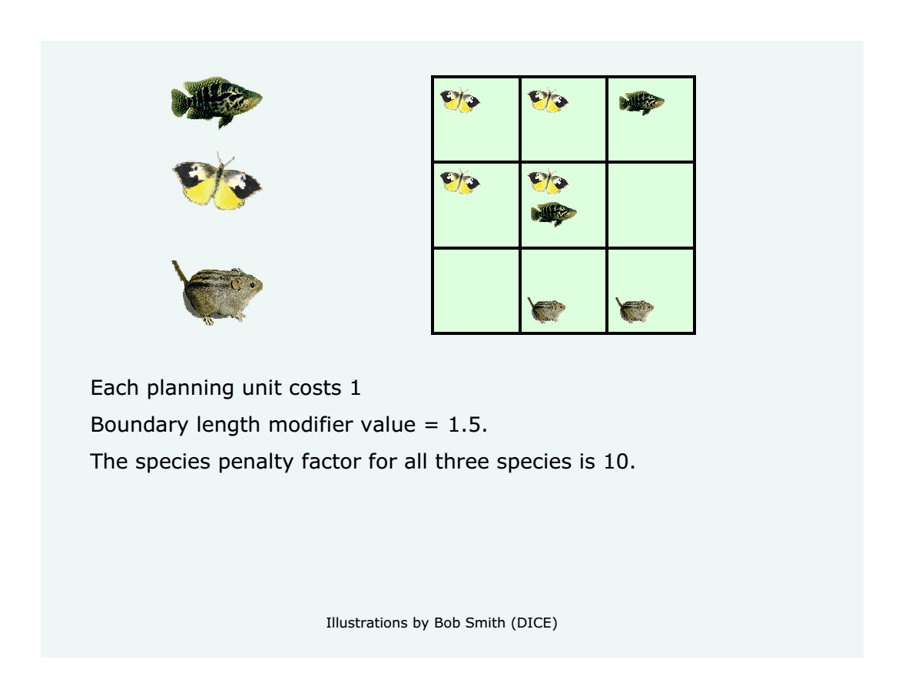

Slide 7
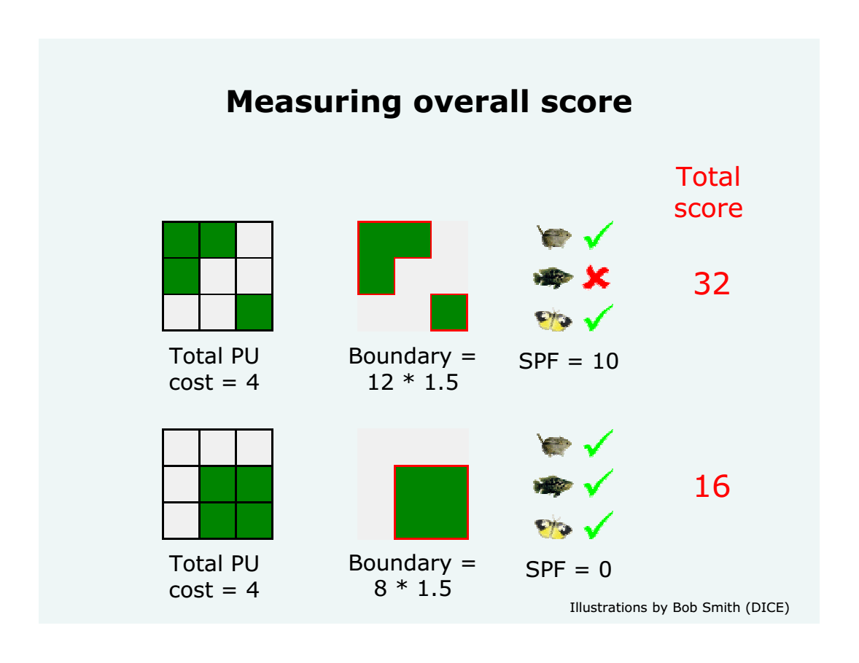
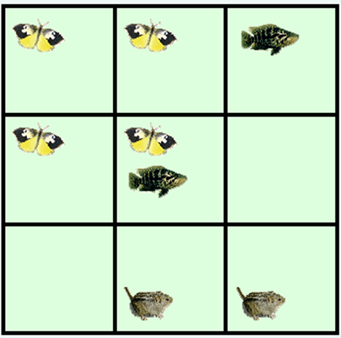

Slide 8
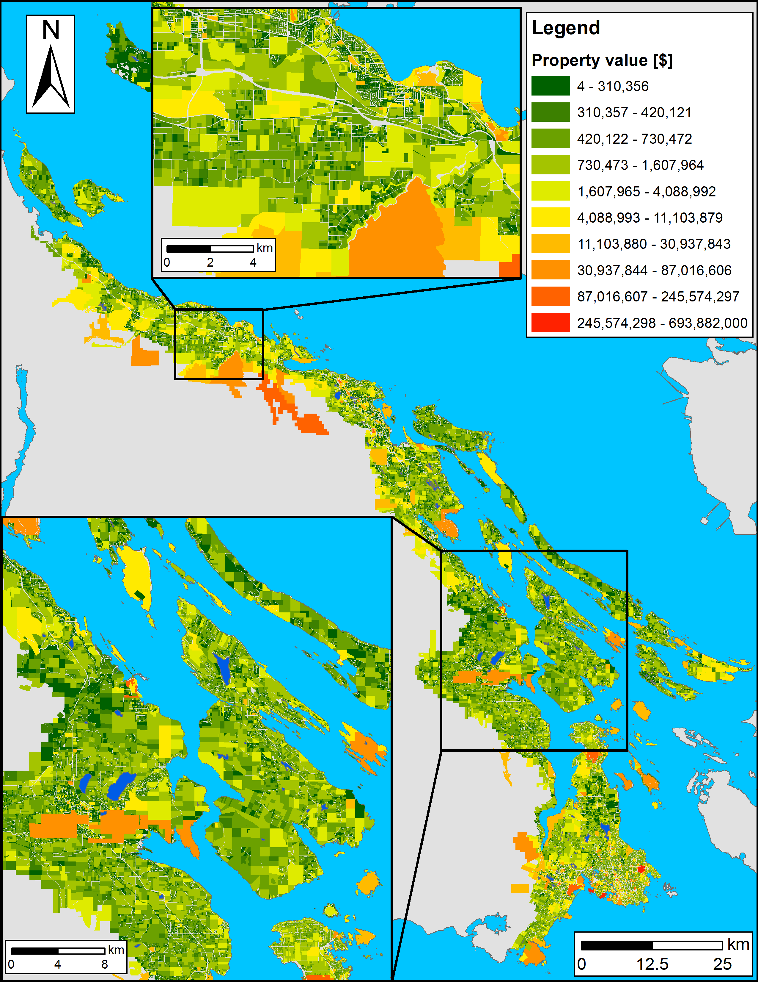
Planning units
Land base of the CDFCP: ~198,000 properties
Possible solutions for a reserve system: 2^198,000 > atoms in the Universe
How to optimize prioritization? Simulated Annealing

Slide 9
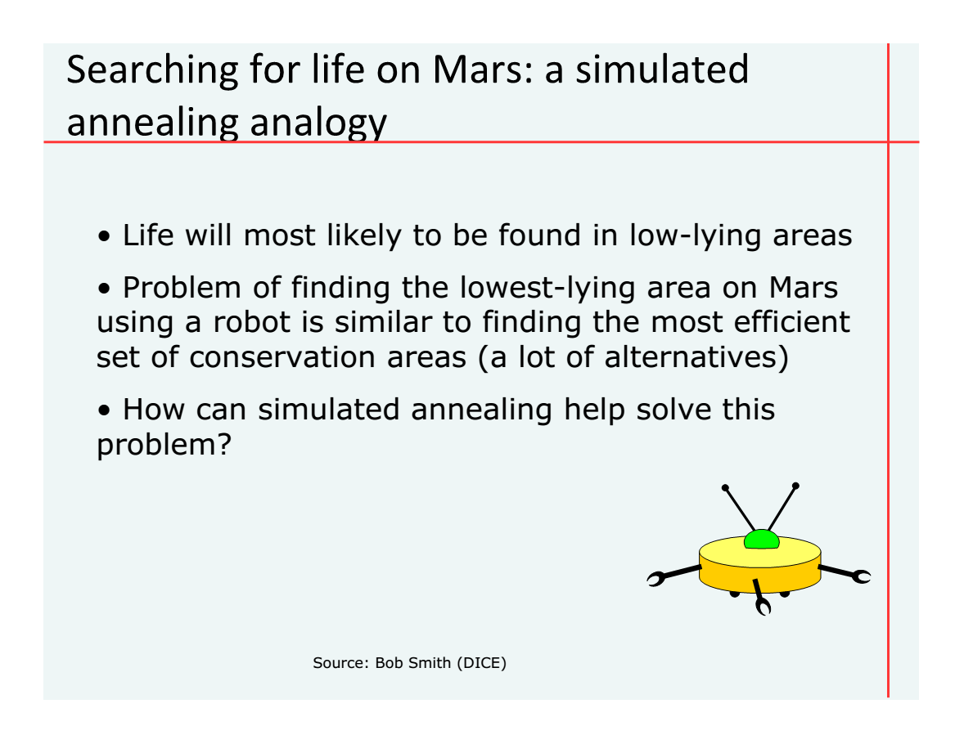

Slide 10
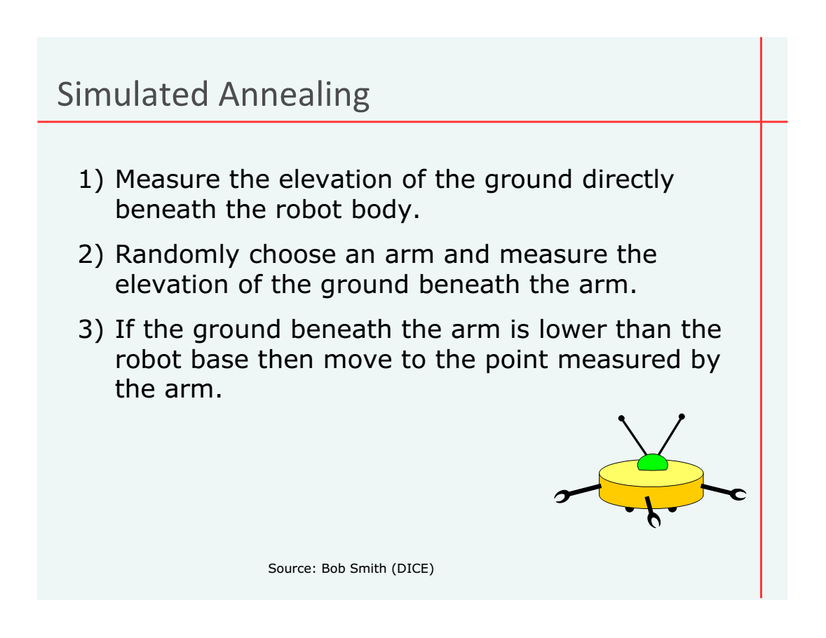

Slide 11
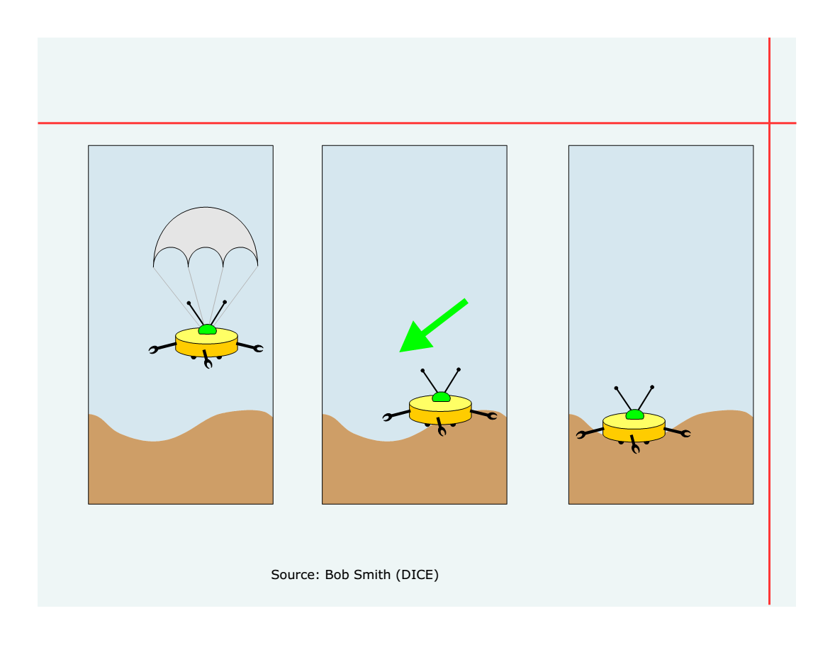

Slide 12
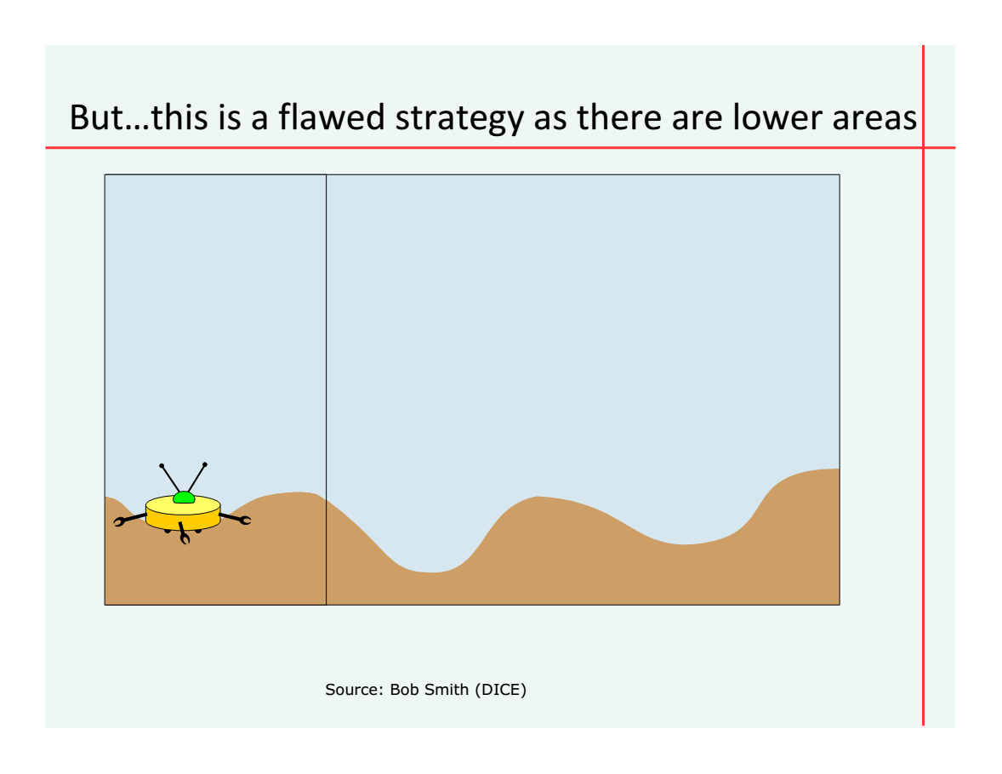

Slide 13
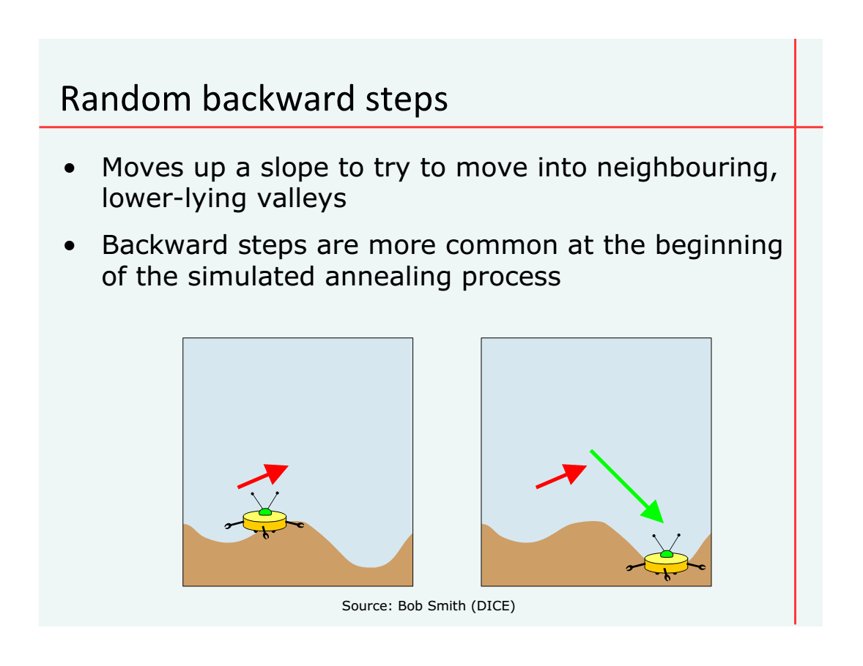

Slide 14
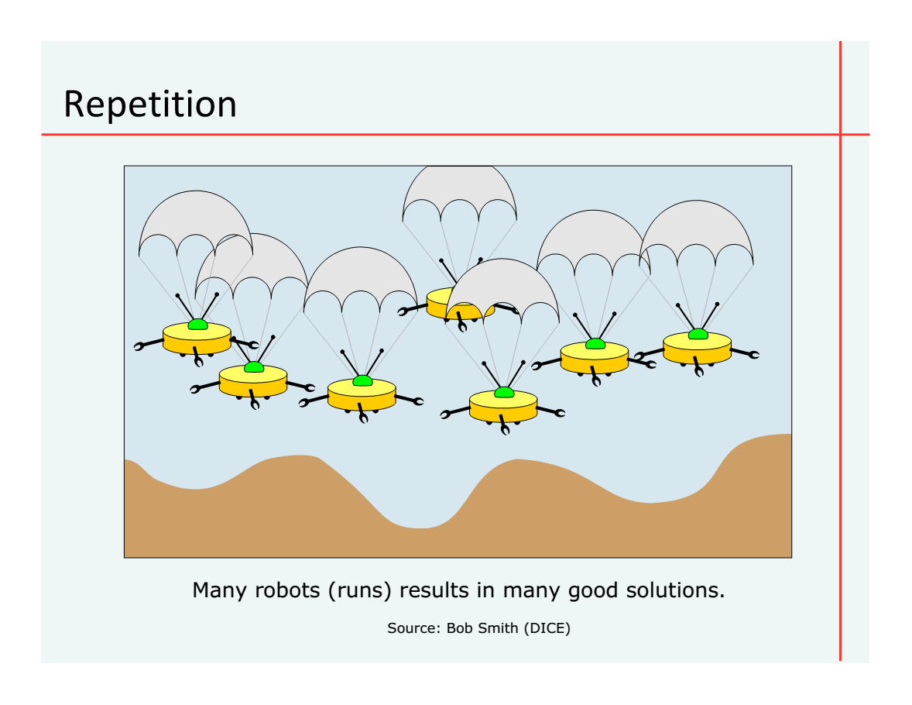

Slide 15










Coastal Douglas Fir Conservation Partnership: Facilitate Consensus Decisions on Protection

Slide 16

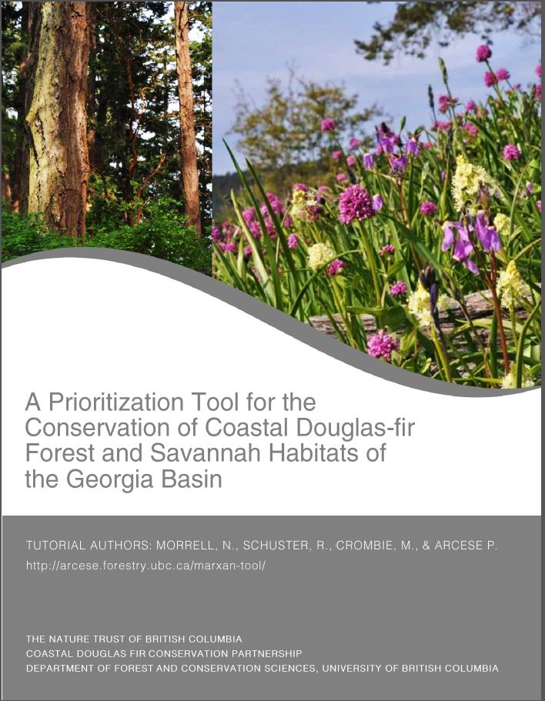
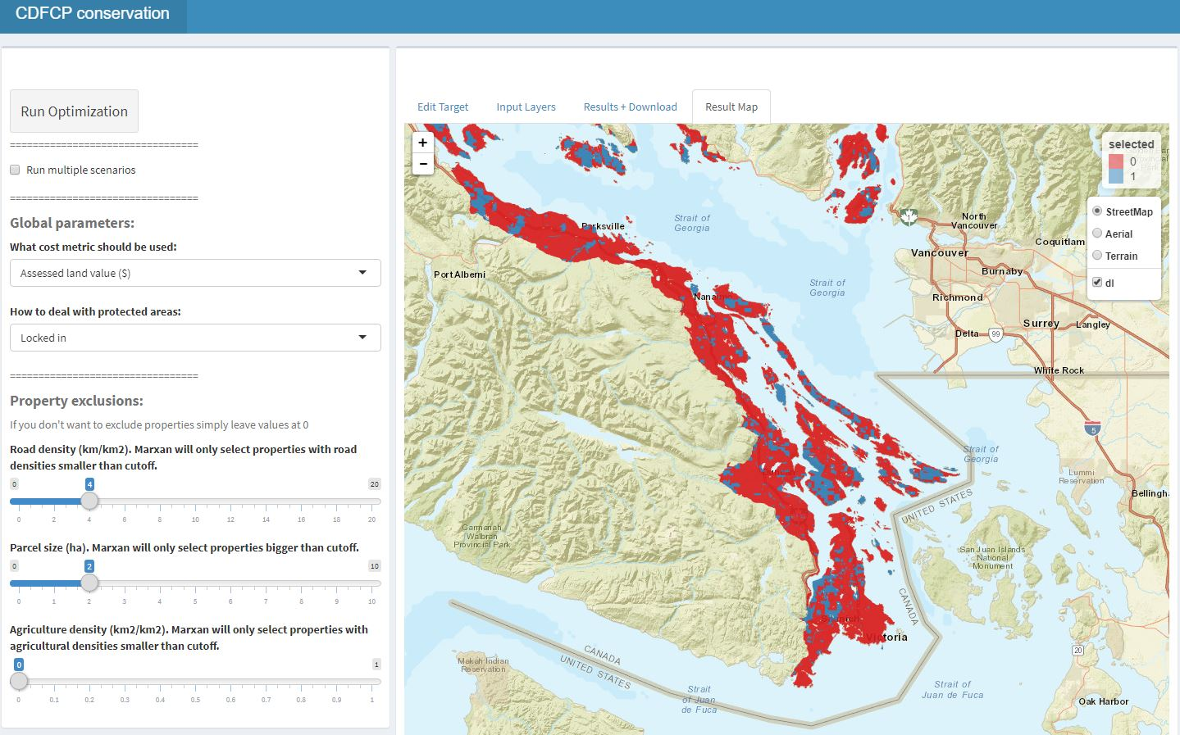
Current tool version
http://forbasin.forestry.ubc.ca/CDFCP.v0.22.3/

Slide 17
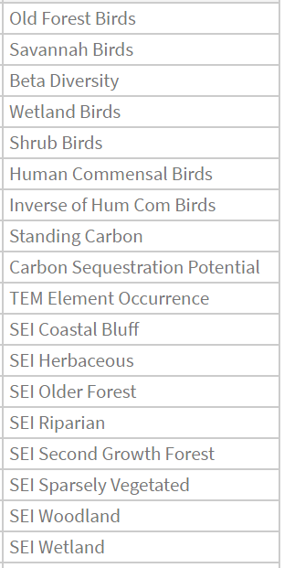
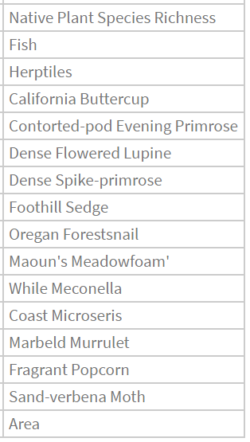

Slide 18
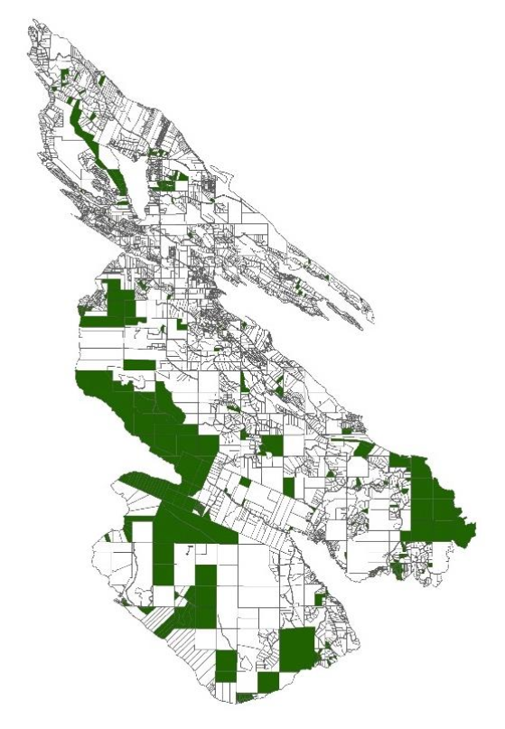
Applications?
Acquire Biodiverse Parcels
Minimize Management Costs, Maximize Return on Conservation Investments
Develop Contact Lists to Engage Private Landowners in Conservation at Landscape Scales

Slide 19
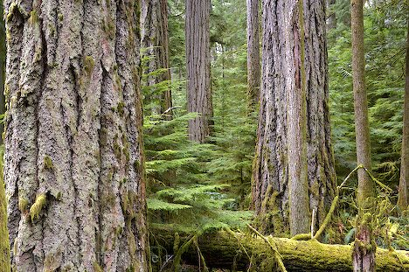
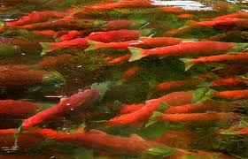

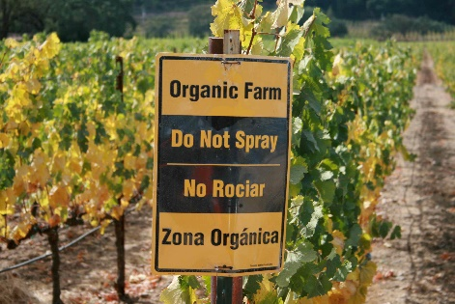
Strategic Investment for ‘Co-benefits’
Standing / Sequestered Carbon
Water Quality / Supply
Beneficial Farm Practices
Notes:
Think of a reverse auction as similar to when a homeowner solicits multiple bids for work from contractors. The homeowner puts together a scope of work, solicit bids, and chooses a contractor based on some combination of factors including price and quality.
Finally, based on estimates of the amount of habitat needed and the pricing of bids, BirdReturns accepted up to 80 percent of the bids. Each farmer received the price they bid. Just as with the contracting example, the lowest price didn’t always win, but it was a key criteria.
Farmer’s bids varied based on factors such as water cost, soil conditions, labor costs associated with creating the temporary habitat, and economic risks the program might create like not being able to plant on time in the spring.
BirdReturns has many advantages over conservation programs that set a single, uniform price for all farmers.
If the price is too low, there will be insufficient demand and too few farmers will sign up for the program. If the price is too high, there will be an excess of demand and the government will over-pay. In a time of huge societal needs and competing demands for scarce public dollars, such over-payment means that other valuable programs are not being funded.
In a reverse auction, the farmer sets the price, a price based on producing habitat. Farmers understand this intuitively. It is how they work, how they get paid for producing crops.
As one farmer put it at one of the Conservancy’s initial meetings: “You want us to grow birds, like we grow rice. We know how to do that.”
Farmer’s bids varied based on factors such as water cost, soil conditions, labor costs associated with creating the temporary habitat, and economic risks the program might create like not being able to plant on time in the spring.

Slide 20
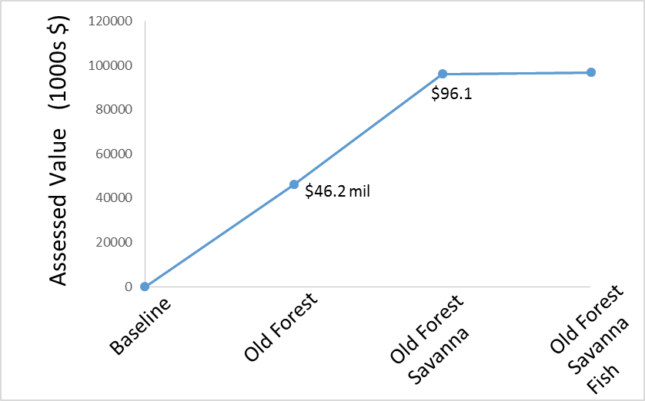
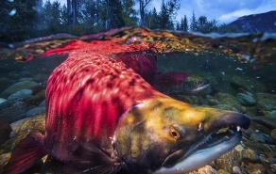

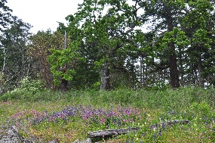
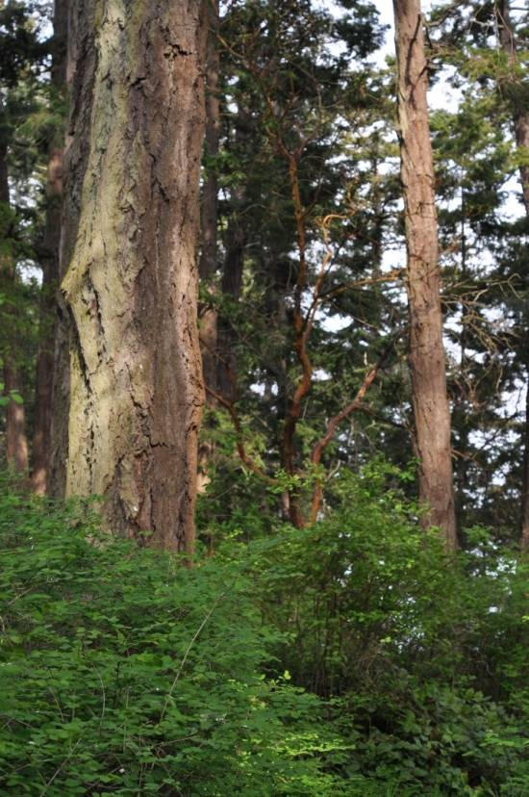
Coastal Douglas-fir Carbon Co-Benefit
$96.7
Vancouver

Slide 21
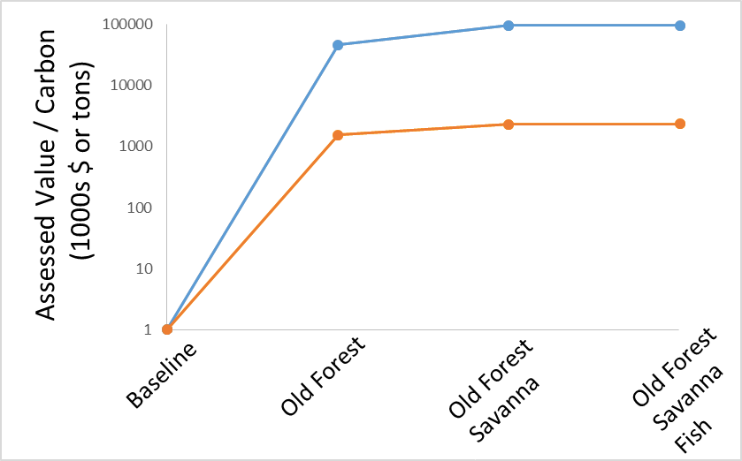
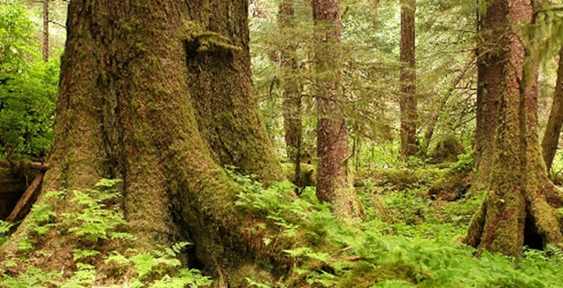
Coastal Douglas-fir Carbon Co-Benefit
Cost of Solution
St + Seq Carbon
$9.7
Canadian Carbon Policy
$20/t by 2020

Slide 22
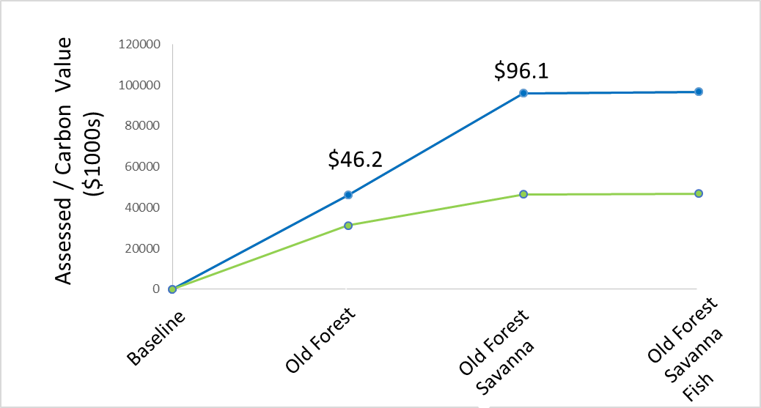
Coastal Douglas-fir Carbon
Co-Benefit
$9.7
$96.7
Who Pays?
Assessed Value - Carbon ($1000s)
$31.2 $46.4 $46.8

Slide 23
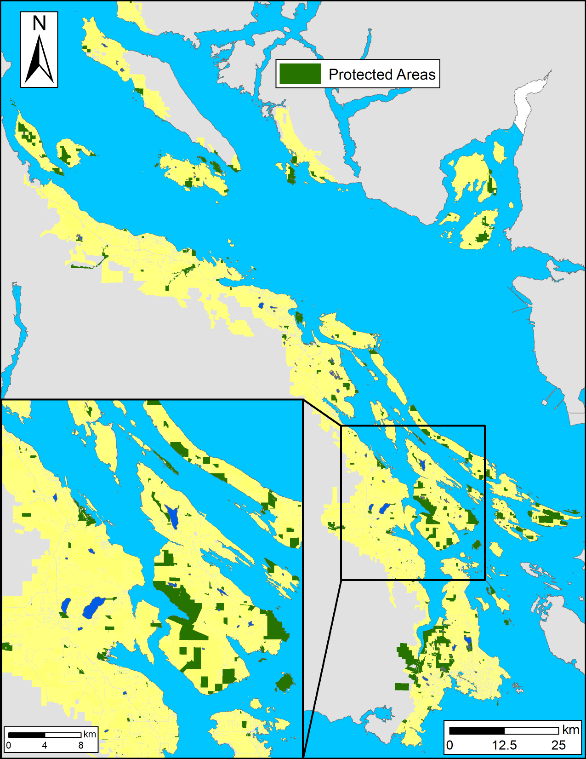
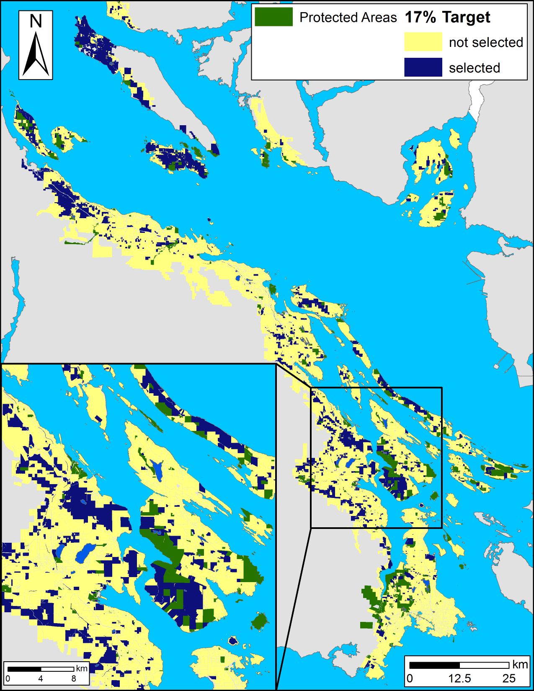
Coastal Douglas-fir
Conservation Partnership Study Area
Meeting Our Commitment to Convention on Biological Diversity
to Increase Protection to 17% from 10% Currently
Cost: $360M

Slide 24
Financing Conservation via ‘Tax Shifting’
Municipal & Provincial Governments Committed to Reduce Net Carbon
Shift Property Tax from High to Low Ranked Parcels to Reflect Existing or Restore Ecosystem Services
Reduction Cost Required Shift
100% $3.13m $2.10 / $1mil
Schuster et al. 2017 Cons. Lett.

Slide 25
Strategic Investment for ‘Co-benefits’
Standing / Sequestered Carbon
Water Quality / Supply
Beneficial Farm Practices
Notes:
Think of a reverse auction as similar to when a homeowner solicits multiple bids for work from contractors. The homeowner puts together a scope of work, solicit bids, and chooses a contractor based on some combination of factors including price and quality.
Finally, based on estimates of the amount of habitat needed and the pricing of bids, BirdReturns accepted up to 80 percent of the bids. Each farmer received the price they bid. Just as with the contracting example, the lowest price didn’t always win, but it was a key criteria.
Farmer’s bids varied based on factors such as water cost, soil conditions, labor costs associated with creating the temporary habitat, and economic risks the program might create like not being able to plant on time in the spring.
BirdReturns has many advantages over conservation programs that set a single, uniform price for all farmers.
If the price is too low, there will be insufficient demand and too few farmers will sign up for the program. If the price is too high, there will be an excess of demand and the government will over-pay. In a time of huge societal needs and competing demands for scarce public dollars, such over-payment means that other valuable programs are not being funded.
In a reverse auction, the farmer sets the price, a price based on producing habitat. Farmers understand this intuitively. It is how they work, how they get paid for producing crops.
As one farmer put it at one of the Conservancy’s initial meetings: “You want us to grow birds, like we grow rice. We know how to do that.”
Farmer’s bids varied based on factors such as water cost, soil conditions, labor costs associated with creating the temporary habitat, and economic risks the program might create like not being able to plant on time in the spring.

Slide 26
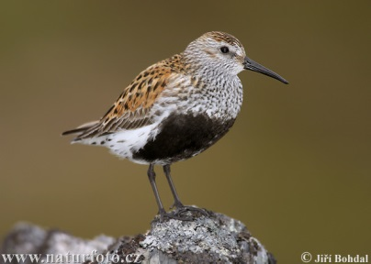
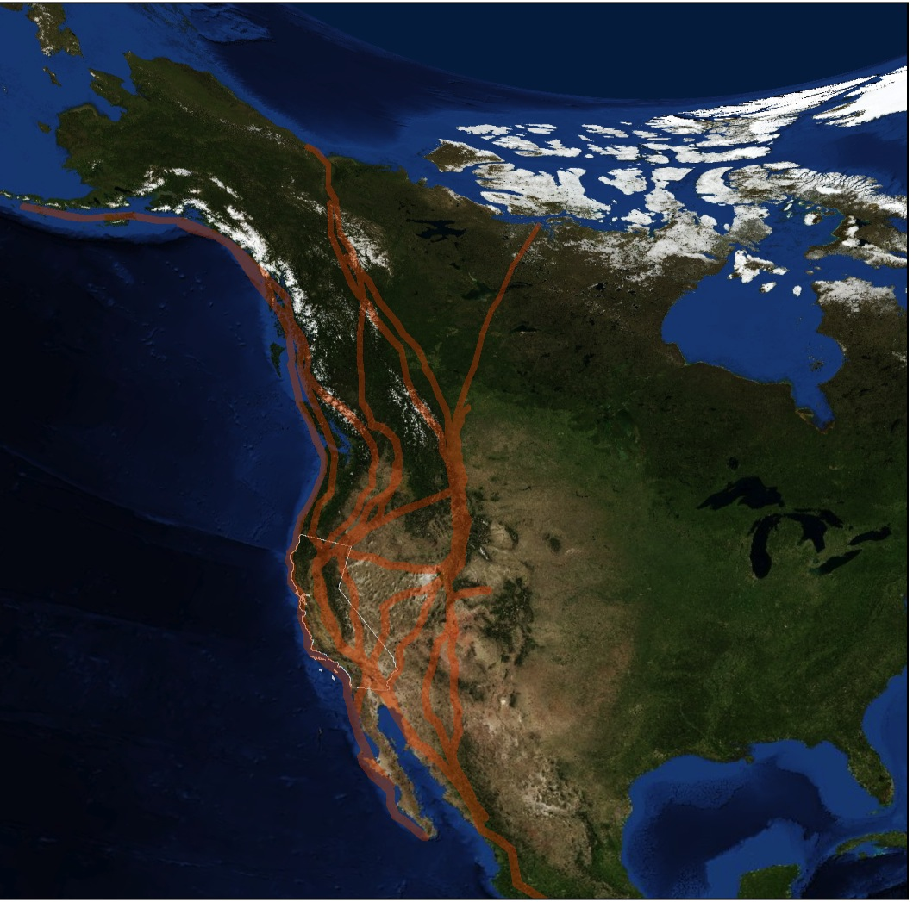
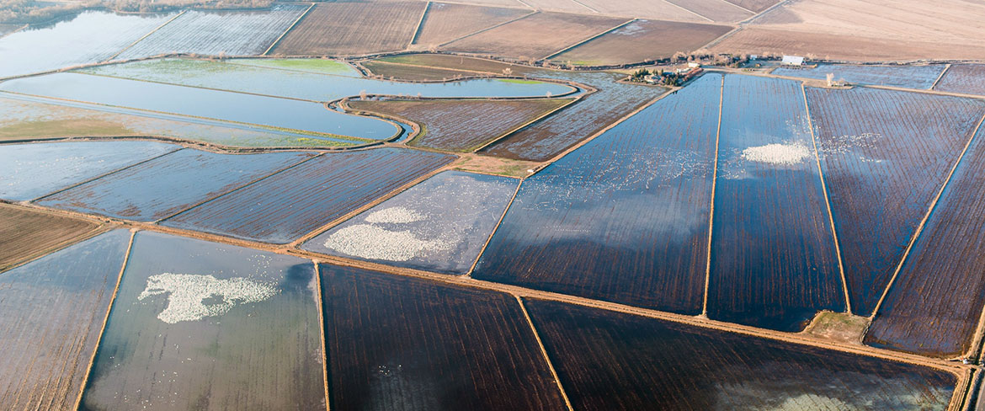
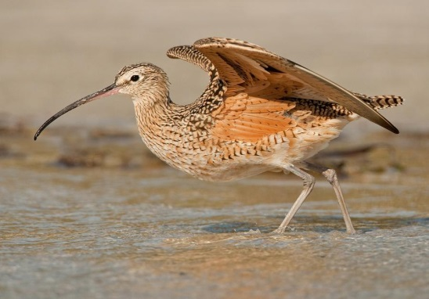
Sacramento Valley Rice Fields – TNC

Slide 27
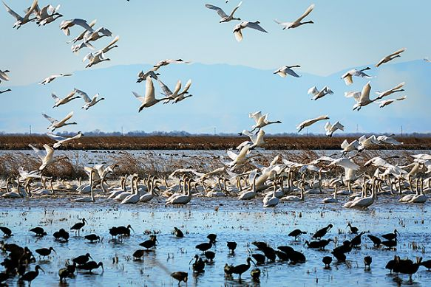
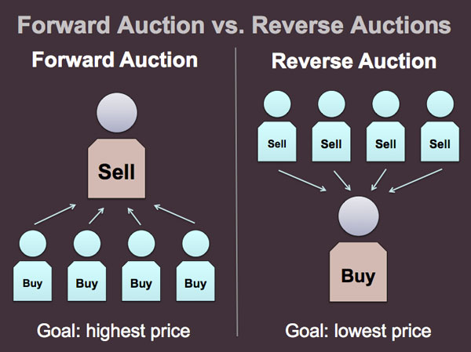
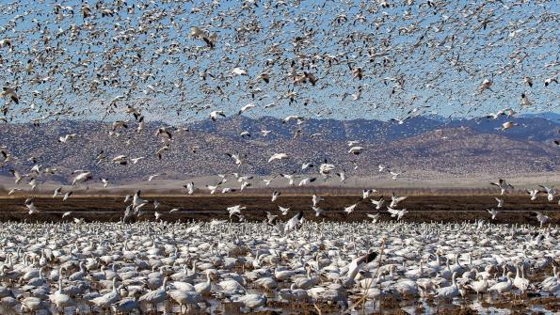
Reverse Auctions
Notes:
Think of a reverse auction as similar to when a homeowner solicits multiple bids for work from contractors. The homeowner puts together a scope of work, solicit bids, and chooses a contractor based on some combination of factors including price and quality.
Finally, based on estimates of the amount of habitat needed and the pricing of bids, BirdReturns accepted up to 80 percent of the bids. Each farmer received the price they bid. Just as with the contracting example, the lowest price didn’t always win, but it was a key criteria.
Farmer’s bids varied based on factors such as water cost, soil conditions, labor costs associated with creating the temporary habitat, and economic risks the program might create like not being able to plant on time in the spring.
BirdReturns has many advantages over conservation programs that set a single, uniform price for all farmers.
If the price is too low, there will be insufficient demand and too few farmers will sign up for the program. If the price is too high, there will be an excess of demand and the government will over-pay. In a time of huge societal needs and competing demands for scarce public dollars, such over-payment means that other valuable programs are not being funded.
In a reverse auction, the farmer sets the price, a price based on producing habitat. Farmers understand this intuitively. It is how they work, how they get paid for producing crops.
As one farmer put it at one of the Conservancy’s initial meetings: “You want us to grow birds, like we grow rice. We know how to do that.”
Farmer’s bids varied based on factors such as water cost, soil conditions, labor costs associated with creating the temporary habitat, and economic risks the program might create like not being able to plant on time in the spring.

Slide 28
Strategic Investment for ‘Co-benefits’
Standing / Sequestered Carbon
Water Quality / Supply
Beneficial Farm Practices
Notes:
Think of a reverse auction as similar to when a homeowner solicits multiple bids for work from contractors. The homeowner puts together a scope of work, solicit bids, and chooses a contractor based on some combination of factors including price and quality.
Finally, based on estimates of the amount of habitat needed and the pricing of bids, BirdReturns accepted up to 80 percent of the bids. Each farmer received the price they bid. Just as with the contracting example, the lowest price didn’t always win, but it was a key criteria.
Farmer’s bids varied based on factors such as water cost, soil conditions, labor costs associated with creating the temporary habitat, and economic risks the program might create like not being able to plant on time in the spring.
BirdReturns has many advantages over conservation programs that set a single, uniform price for all farmers.
If the price is too low, there will be insufficient demand and too few farmers will sign up for the program. If the price is too high, there will be an excess of demand and the government will over-pay. In a time of huge societal needs and competing demands for scarce public dollars, such over-payment means that other valuable programs are not being funded.
In a reverse auction, the farmer sets the price, a price based on producing habitat. Farmers understand this intuitively. It is how they work, how they get paid for producing crops.
As one farmer put it at one of the Conservancy’s initial meetings: “You want us to grow birds, like we grow rice. We know how to do that.”
Farmer’s bids varied based on factors such as water cost, soil conditions, labor costs associated with creating the temporary habitat, and economic risks the program might create like not being able to plant on time in the spring.

Slide 29

Conclusions
Composite Occupancy Maps Offer a Direct Route to Site Prioritization
Parcel-level Prioritization Aids Decision-making by Engaging Stakeholders in Targets, Goal-setting and Policy Scenarios
Of ~600 Species At Risk in Canada, ~450 Rely on Human-dominated Landscapes, where <10% of Historic Ecosystems have been Conserved
Meeting Treaty Targets to Conserve 17% of Terrestrial Ecosystems and Stem Extinction will Require Strategic Incentivizes to Conserve Private Land

Slide 30
Current work: Optimizing conservation of migratory species over their full annual cycle in the Western Hemisphere
Relative abundance models from eBird
109 Neotropical migrant bird species
Full annual cycle

Slide 31
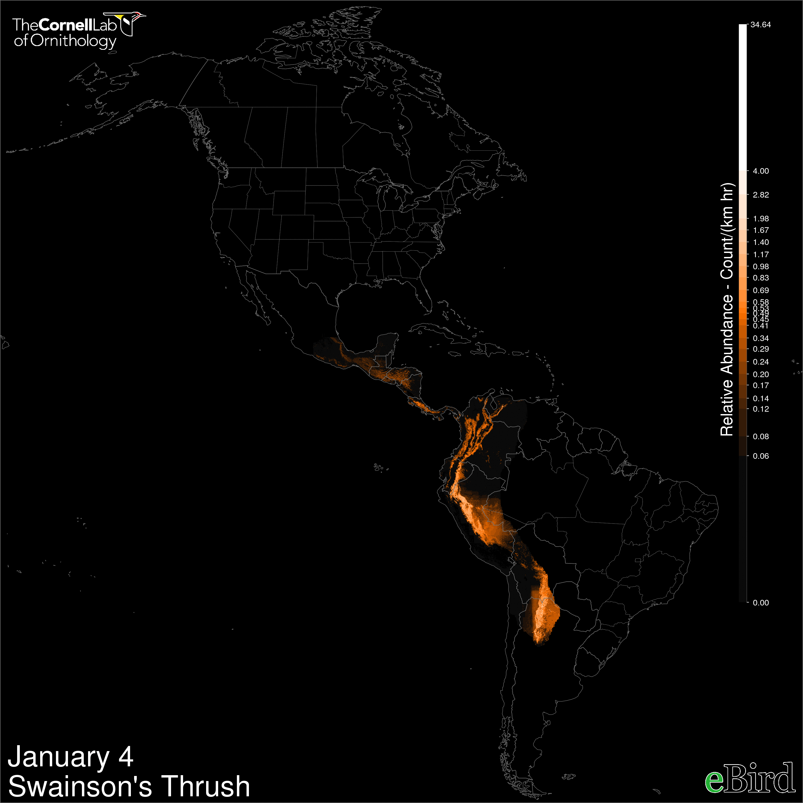
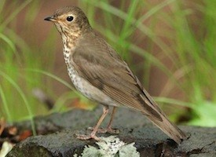


Slide 32
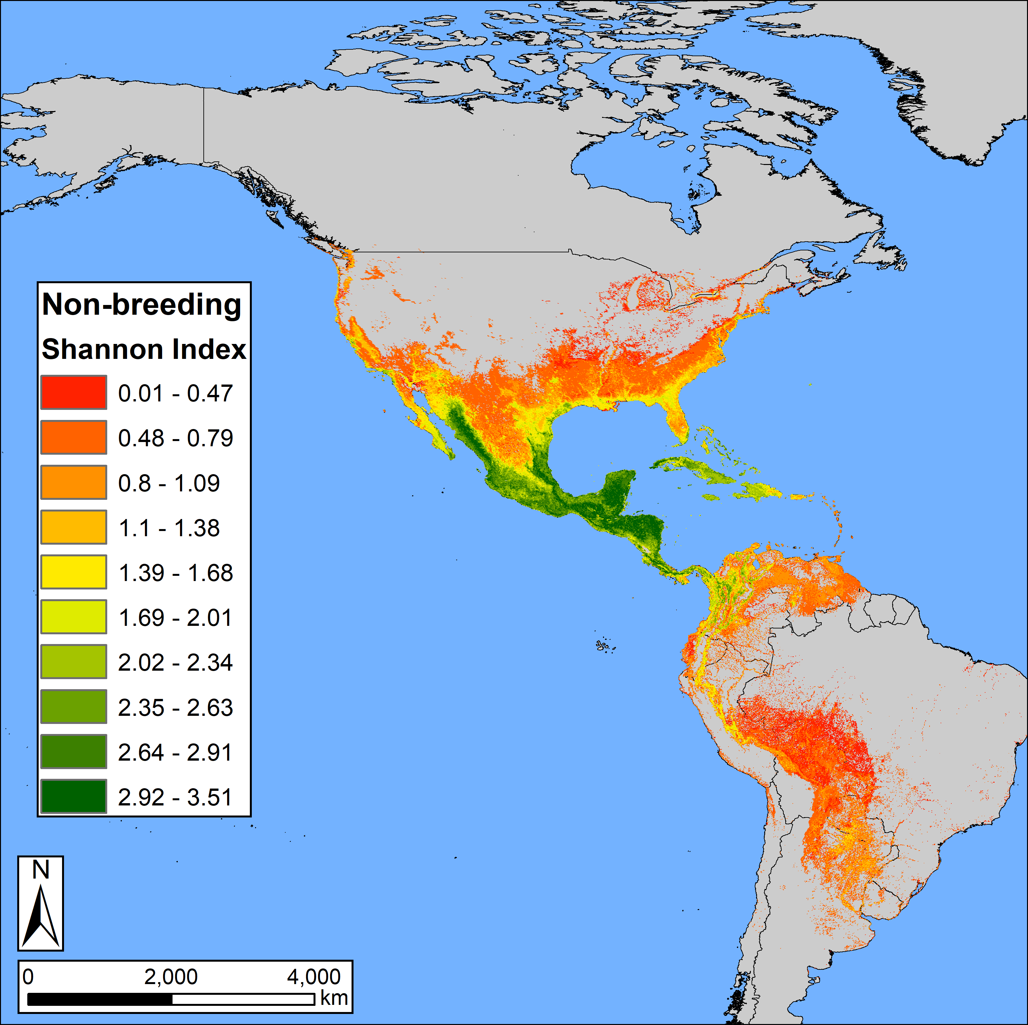
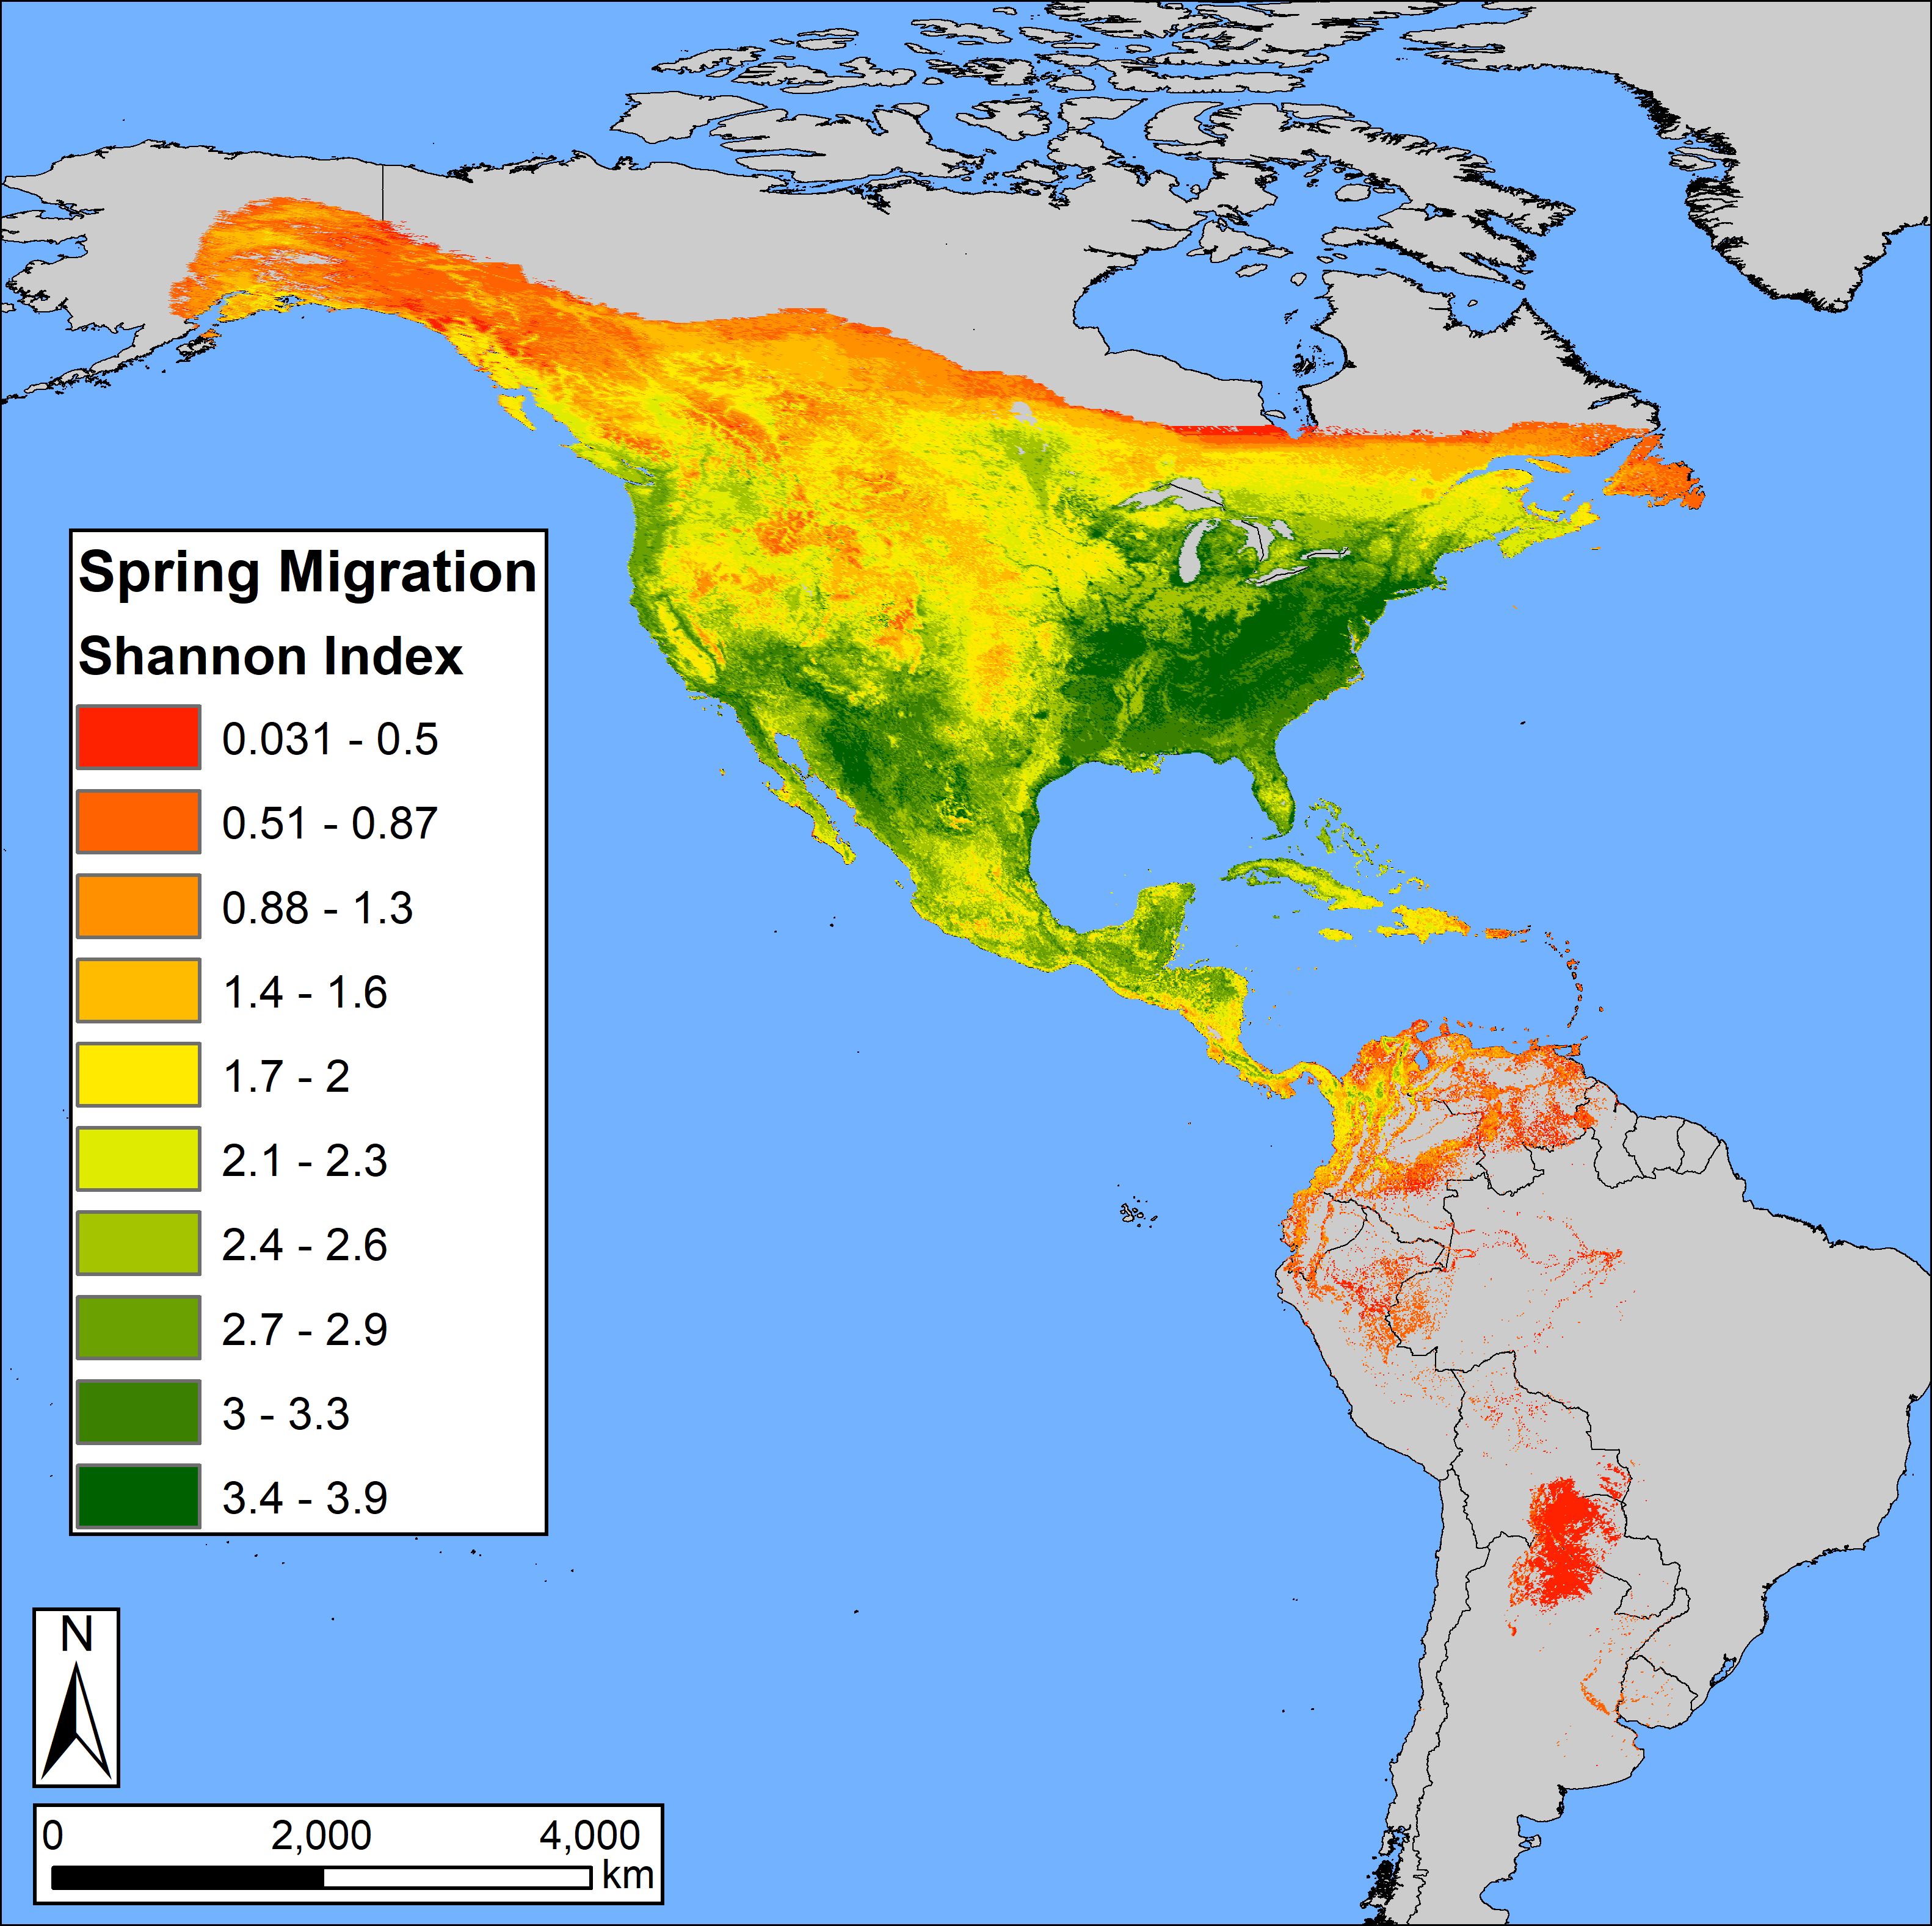
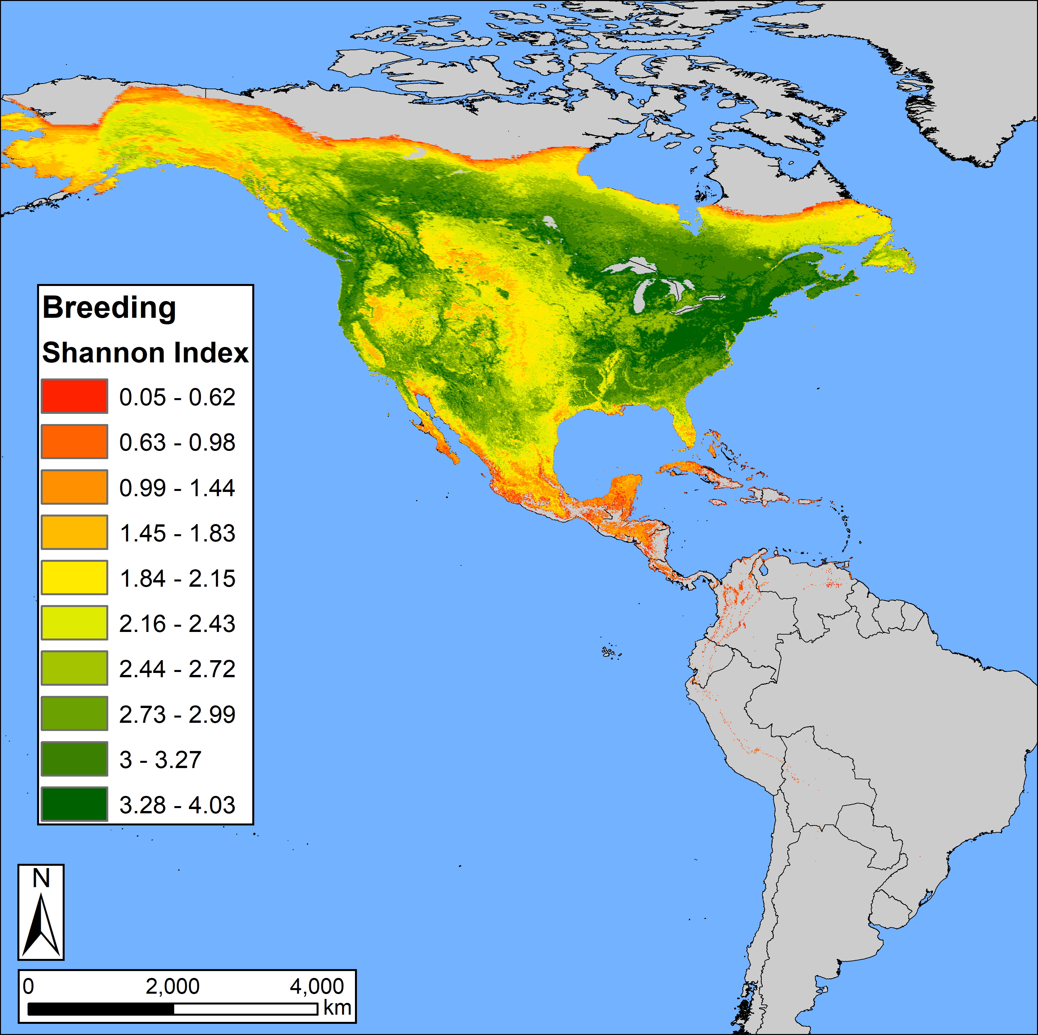
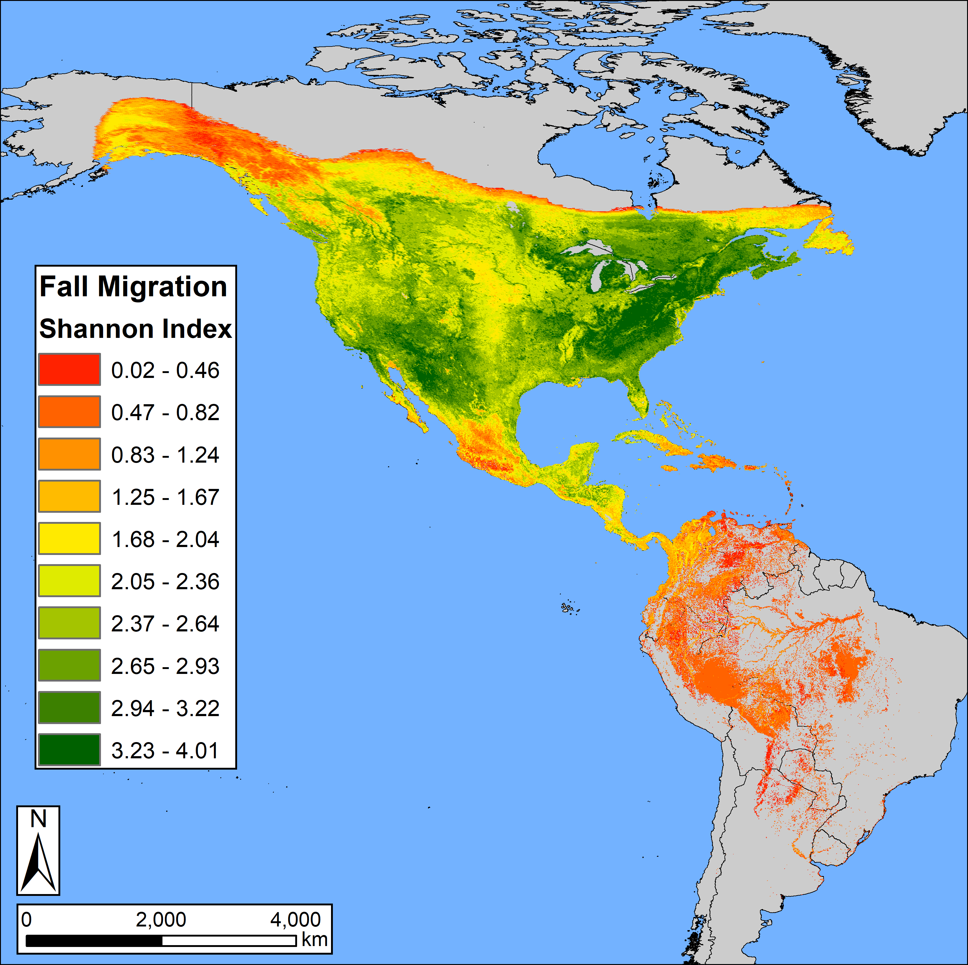
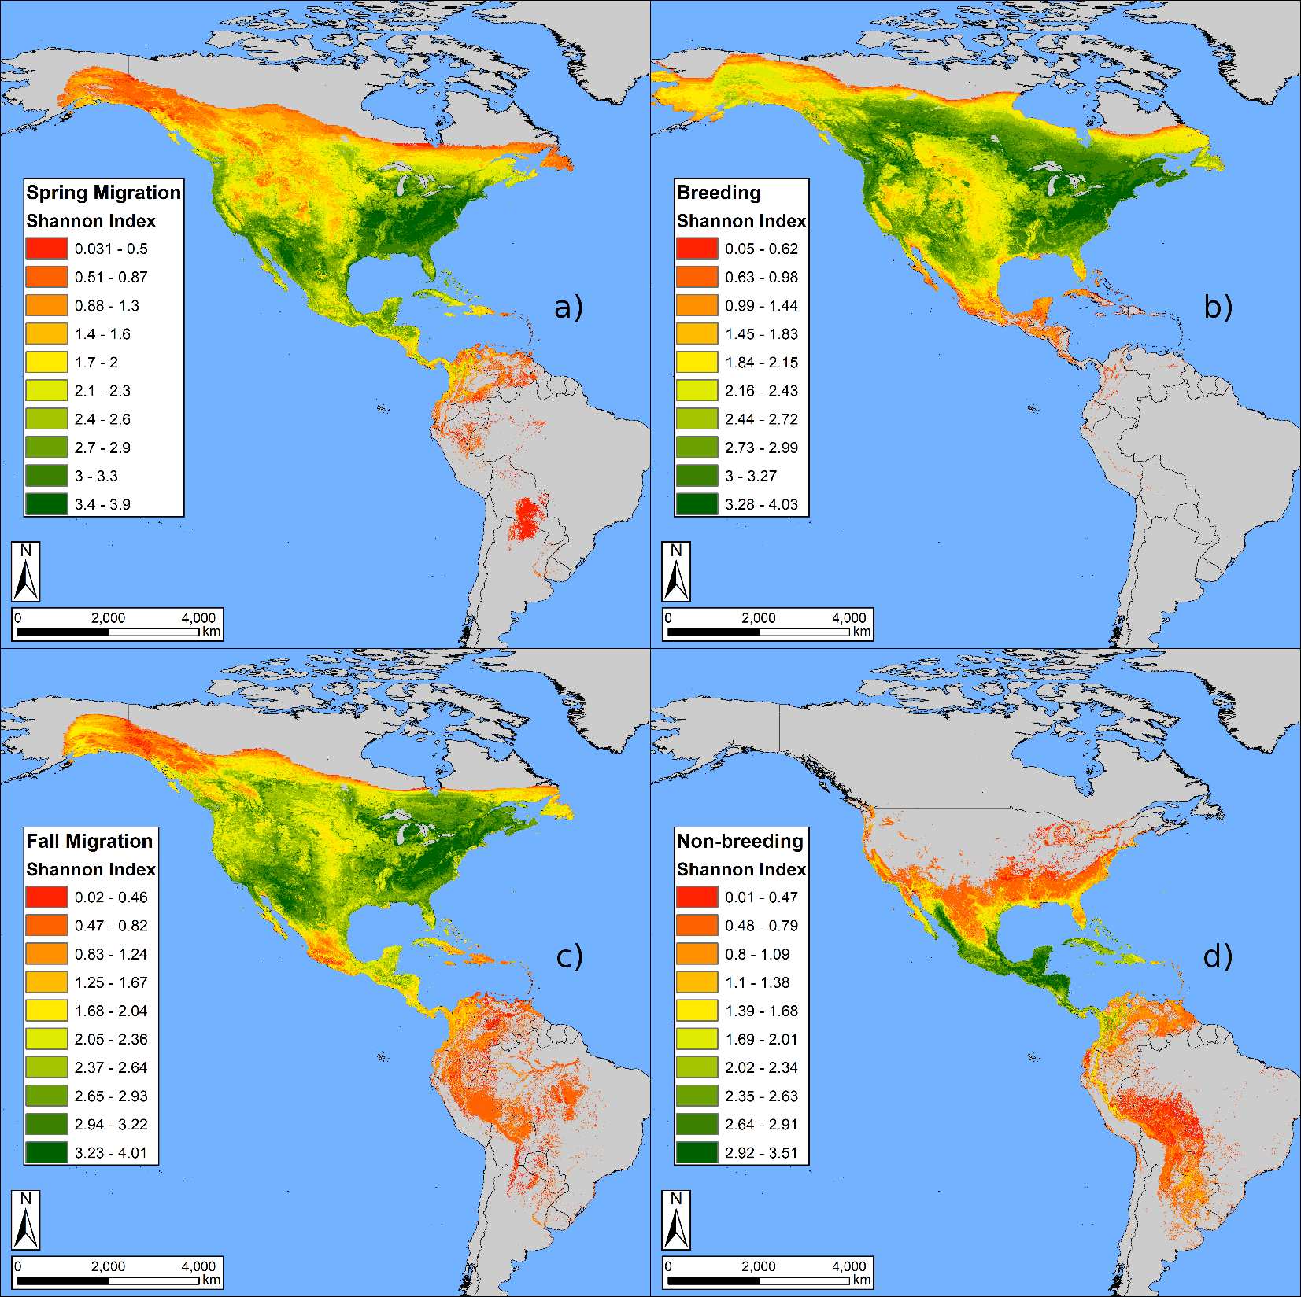

Slide 33
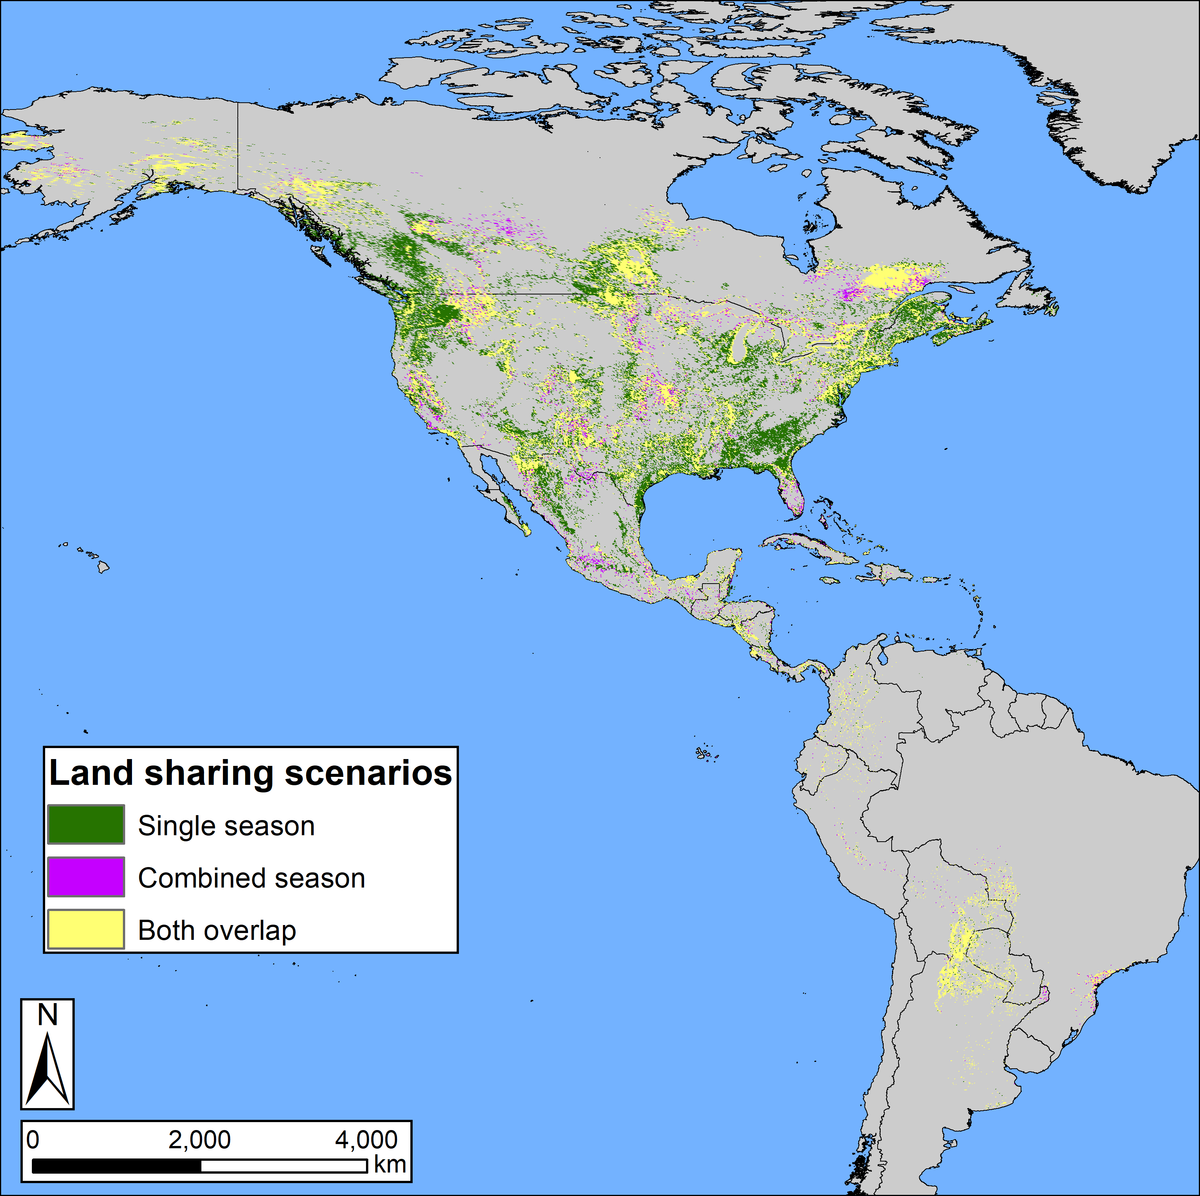
Annual cycle plans were more efficient than single-season plans and reduced the area needed to meet 17% targets by up to 43%.

Slide 34
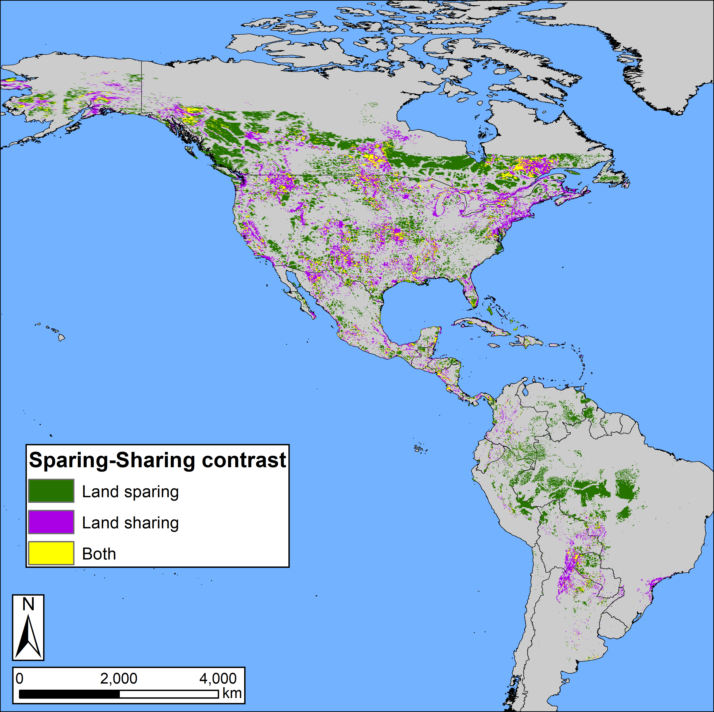
Area efficiency was maximized when land converted by human activity (e.g., agricultural, urban) was included in solutions, suggesting that working landscapes contribute positively to conservation.

Slide 35




prioritizr
Hanson JO, Schuster R, Morrell N, Strimas-Mackey M, Watts ME, Arcese P, Bennett J, Possingham HP (2017). prioritizr: Systematic Conservation Prioritization in R. R package version 3.0.3.
https://github.com/prioritizr/prioritizr

Slide 36

Under development
Combine CDFCP tool with prioritizr to allow users to interactively build and customize conservation planning problems.

